Slide 1
Character Question
Studied Drama: Romeo and Juliet
Aoife O’Driscoll www.aoifesnotes.com

Slide 2
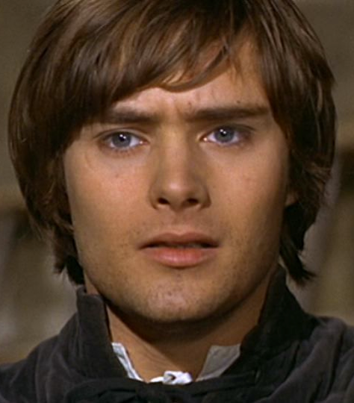
Areas to consider when structuring your answer
Introduction
Challenges
Crisis
Resolution
Final impression
Aoife O’Driscoll www.aoifesnotes.com

Slide 3
Structuring your answer
Paragraph One: The play I have studied for my Junior Certificate is William Shakespeare’s classic tragedy ‘Romeo and Juliet’.
Next sentence should answer the question directly: The character who I feel has undergone most change over the course of the play is Romeo.
Aoife O’Driscoll www.aoifesnotes.com

Slide 4
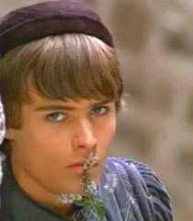
Paragraph Two: First Impression
Self-centred and moody
Romeo is obsessed with Rosaline and cannot see that this is not real love.
He ‘Shuts up his windows’ and ‘makes himself an artificial night’
Romeo does not seem to care that he is worrying his parents and his friends.
He is so caught up in his own woes that he says he sinks ‘under love’s heavy burden’.
Aoife O’Driscoll www.aoifesnotes.com

Slide 5
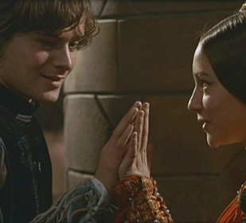
Paragraph Three: Changeable
When he meets Juliet, all thoughts of Rosaline vanish from Romeo’s mind.
‘Did my heart love till now?’
Friar Laurence is astonished that Rosaline could be ‘So soon forsaken’.
Aoife O’Driscoll www.aoifesnotes.com

Slide 6
Paragraph Four: Impulsive
Romeo falls deeply in love with Juliet the moment he meets her.
He cannot leave the Capulets’ house, saying, ‘Can I go forward when my heart is here?’
He doesn’t care if he is found in the orchard; he is willing to risk anything to be with Juliet.
Aoife O’Driscoll www.aoifesnotes.com

Slide 7
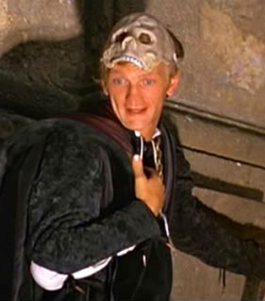
Paragraph Five: Happy and light-hearted
When Romeo loved Rosaline he was miserable and unsociable.
Now that he is in love with Juliet, he is in good spirits again.
Mercutio comments on this: ‘Now art thou sociable, now art thou Romeo’.
Romeo is even willing to make peace with Tybalt.
Aoife O’Driscoll www.aoifesnotes.com

Slide 8
Paragraph Six: Still rather immature
When Tybalt kills Mercutio, Romeo avenges his death without thinking of the consequences.
The moment he has killed Tybalt, Romeo wails that he is ‘Fortune’s fool’ and Benvolio has to urge him to leave before he is arrested.
Even though he is married now, Romeo still does not act like a man, throwing himself to the ground and weeping in the friar’s cell.
The Friar says that Romeo’s tears ‘are womanish’ and the Nurse tells him to be a man ‘for Juliet’s sake’.
Aoife O’Driscoll www.aoifesnotes.com

Slide 9
Paragraph Seven: Heartbroken but brave and determined
When Romeo hears of Juliet’s death, he is so distraught that he immediately wants to die too: ‘Well, Juliet, I will lie with thee to-night’.
Instead of running to the Friar for help or bemoaning his fate, Romeo decides to take action. He buys poison and rides back to Verona as fast as he can.
He shows dignity and decency in his dealings with Paris, begging him not to fight and placing him in the tomb with Juliet when he has killed him.
Aoife O’Driscoll www.aoifesnotes.com

Slide 10
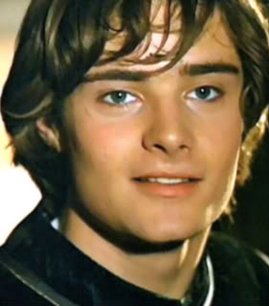
Paragraph Eight: Final Impression
Romeo is a young man who has to cope with great joy and great heartbreak within a very short space of time.
He moves from being a rather self-centred and childish boy to a young husband whose wife is the centre of his world.
Tragic death of a character who was not perfect but was likeable, loving and true to the end.
Aoife O’Driscoll www.aoifesnotes.com

